Slide 1
DIABETES DETECTION SYSTEM
Team Members :
1.Meenakshi.H
2.Sunitha.B
3.Rajadurai.R
4.Vishak.S.P
Faculty Guide Name : Mr. S.Suseendran
Industrial Guide :
Department of CSE, KGiSL Institute of Technology, Coimbatore

Slide 2
Agenda
Abstract
Objective
Introduction
Literature survey
Architecture Design
Algorithm Results
Conclusion

Slide 3
Abstract Diabetes is considered as one of the deadliest and chronic diseases which causes an increase in blood sugar. Many complications occur if diabetes remains untreated and unidentified. The aim of our project is to develop a system which can perform early prediction of diabetes for a patient with a higher accuracy by combining the results of different machine learning techniques. Our project aims to predict diabetes via three different supervised machine learning methods including: SVM, Logistic regression, ANN. The performances of all the three algorithms are evaluated on various measures like Precision, Accuracy, F-Measure, and Recall.
Department of CSE, KGiSL Institute of Technology, Coimbatore

Slide 4
Objective & Outcome
Objective
The objective of the project is to develop a system that detects the diabetes with the factors we give.
Outcome:
Patients can detect their diabetes with the factors and they can also get the preventive measures for diabetes.

Slide 5
Introduction
MACHINE LEARNING:
Machine learning is an application of artificial intelligence (AI) that provides systems the ability to automatically learn and improve from experience without being explicitly programmed. Machine learning focuses on the development of computer programs that can access data and use it learn for themselves

Slide 6
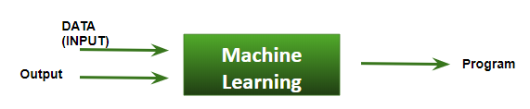
Machine learning algorithms build a mathematical model based on sample data, known as "training data", in order to make predictions or decisions without being explicitly programmed to perform the task.
We feed in DATA(Input) + Output, run it on machine during training and the machine creates its own program(logic), which can be evaluated while testing.

Slide 7
Existing system- Area Introduction The early prediction of diabetes is challenging for the medical practitioners by traditional methods. It needs many physical and chemical tests to be taken. And there are various factors for increase in glucose level for each human.
Department of CSE, KGiSL Institute of Technology, Coimbatore

Slide 8
Literature
TITLE | PUBLICATION YEAR | PUBLISHER | DESCRIPTION
An intelligent system for diabetes prediction | 2014 | IEEE | The results show that the joint implementation of two algorithms improves significantly the overall reliability of the system outcome, which is crucial in the computer-supported diabetes diagnostic process
Diabetes Disease Prediction Using Machine Learning on Big Data of Healthcare | 2017 | IEEE | Experimental results of each algorithm used on the dataset was evaluated. It is observed that Support Vector Machine performed best in prediction of the disease having maximum accuracy.

Slide 9
TITLE | PUBLICATION YEAR | PUBLISHER | DESCRIPTION
Risk prediction model for type2 | 2016 | IEEE | The validation results at UCI Pima Indian diabetes dataset shows that the model has better accuracy and classification performance than other research results mentioned in the literature. As a result, it has been proven that the model would be effective for the diagnosis of diabetes at the initial stage
Hybird prediction Model | 2017 | IEEE | The main objective of this project is to create a fast, effective and reliable.

Slide 10
Proposed System Advantages over existing methods:
Helps to manage diabetes by sustaining the physiological blood glucose level.
Single optimized algorithms to identify optimum ability to gain best possible accuracy for the classification purpose
Future Enhancements:
It gives prevention to reduce the blood glucose level.
Department of CSE, KGiSL Institute of Technology, Coimbatore

Slide 11
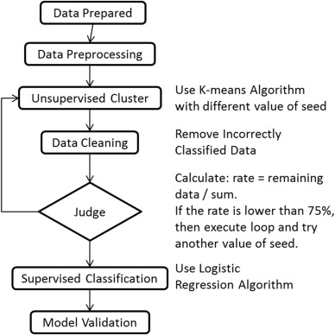
Flow Chart

Slide 12
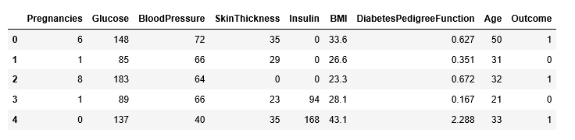
Screenshots
Sample Dataset

Slide 13
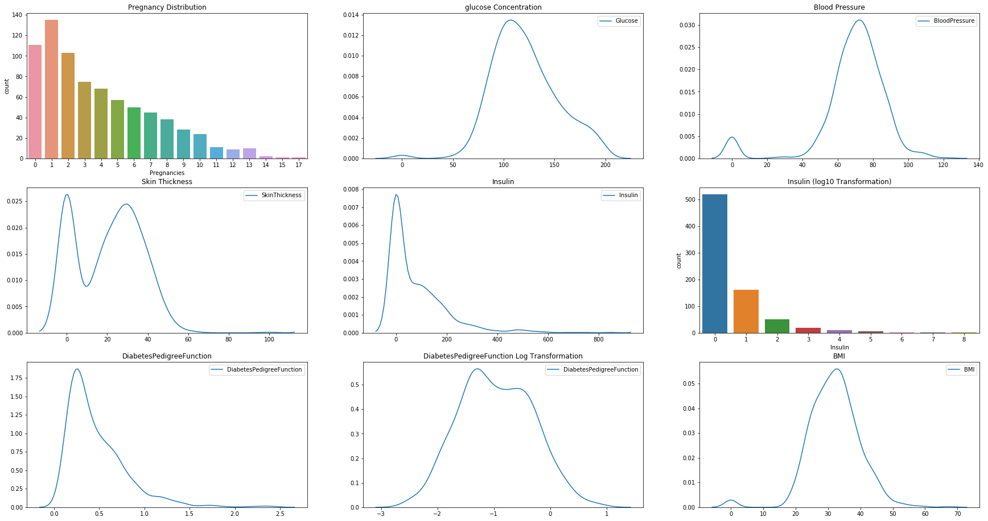

Slide 14
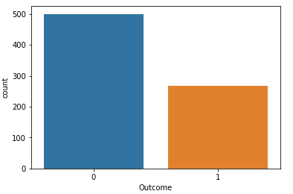
dimension of diabetes data

Slide 15
Drawbacks:
Drawbacks of existing methods
The main problems we solved are improving accuracy of prediction model and making the model to adapt to different datasets
Department of CSE, KGiSL Institute of Technology, Coimbatore

Slide 16
Conclusion Diabetes mellitus is a disease, which can cause many complications. How to exactly predict and diagnose this disease by using machine learning is worthy studying.
We have described a machine learning approach to predicting blood glucose levels and presented the results of recent experiments in hypoglycemia prediction
Training the model using six different classification algorithms, we obtain a precision equal to 0.757 and the recall of 0.762 after the best features selection step
Department of CSE, KGiSL Institute of Technology, Coimbatore

Slide 17
Reference Alghamdi, M., Al-Mallah, M., Keteyian, S., Brawner, C., Ehrman, J., and Sakr, S. (2017). Predicting diabetes mellitus using SMOTE and ensemble machine learning approach: the henry ford exercise testing (FIT) project. PLoS One 12:e0179805. doi: 10.1371/journal.pone.0179805 Leanne Bellamy, Juan-Pablo Casas, Aroon D Hingorani, and David Williams. 2009. Type 2 diabetes mellitus after gestational diabetes: a systematic review and meta-analysis. The Lancet 373, 9677 (2009), 1773–1779

Slide 18
Thank You!!!
Department of CSE, KGiSL Institute of Technology, Coimbatore

